Slide 1
Green University Student portal website test
Kowser Ahmed Sajol ID 183002049
Juliet Jahan ID 183002122

Slide 2
Agenda
Introduction
Objective
Tools and techniques
Test Plan
Summary

Slide 3
Introduction
A simple website testing operation which will operate at Green University’s official student portal by using selenium and chrome driver.

Slide 4
Objective
Subtitle
• To test the integrity of the website.
• To test the button if the perform well.

Slide 5
Tools and techniques
IDE: Apahe Netbeans
Language: JAVA
Selenium
WebDriver

Slide 6
Test Plan
Check input fields
Check Input Buttons
Check Profile name and ID
Check Page title
Check Balance
Check footer

Slide 7
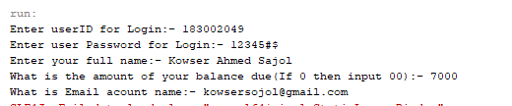
Test Inputs

Slide 8
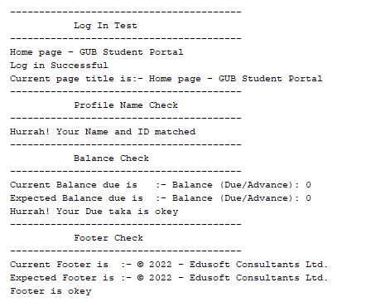
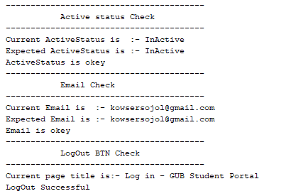
Test Results

Slide 9
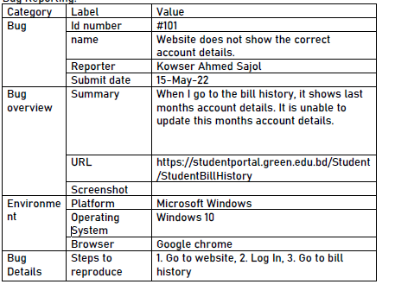
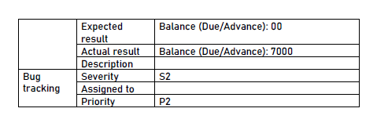
Bug report

Slide 10


Summary
Software testing is an essential part of the software industry. It has a big role in the software industry. Our idea was to execute a test in our university student portal and we are proud to say that we have our success.

Slide 11
Thank you
Kowser Ahmed Sajol
Juliet Jahan
kowsersojol@gmail.com
julietjahan0@gmail.com

